Slide 1
Introduction to IATI
23 January 2017, Brussels
Facilitator:
Sarah Johns,
Transparency Adviser, Bond

Slide 2
The workshop
0 – 60 minutes
Brief presentation on the International Aid Transparency Initiative and open data standard.
Look at IATI data in ‘human-friendly’ website d-portal
Discussion of the types of information shared via IATI: project information, financial information and results
60 – 120 minutes
Talking together about risks and benefits of sharing open IATI data
Decisions that your organisation needs to make before you start using IATI
Creating your organisation’s IATI identifier
120 minutes – 180 minutes
Using the free software ‘AidStream’ to share information using IATI

Slide 3
What does IATI aim to achieve?
Vision:
Transparent, good quality information on development resources and results is available and used by all stakeholder groups to help achieve sustainable development outcomes.
Mission:
The IATI community works together to 1) ensure transparency of data on development resources and results; 2) ensure the quality of IATI data is continually improved and responds to the needs of all stakeholders and 3) facilitate access to effective tools and support so that IATI data contributes to the achievement of sustainable development outcomes.

Slide 4
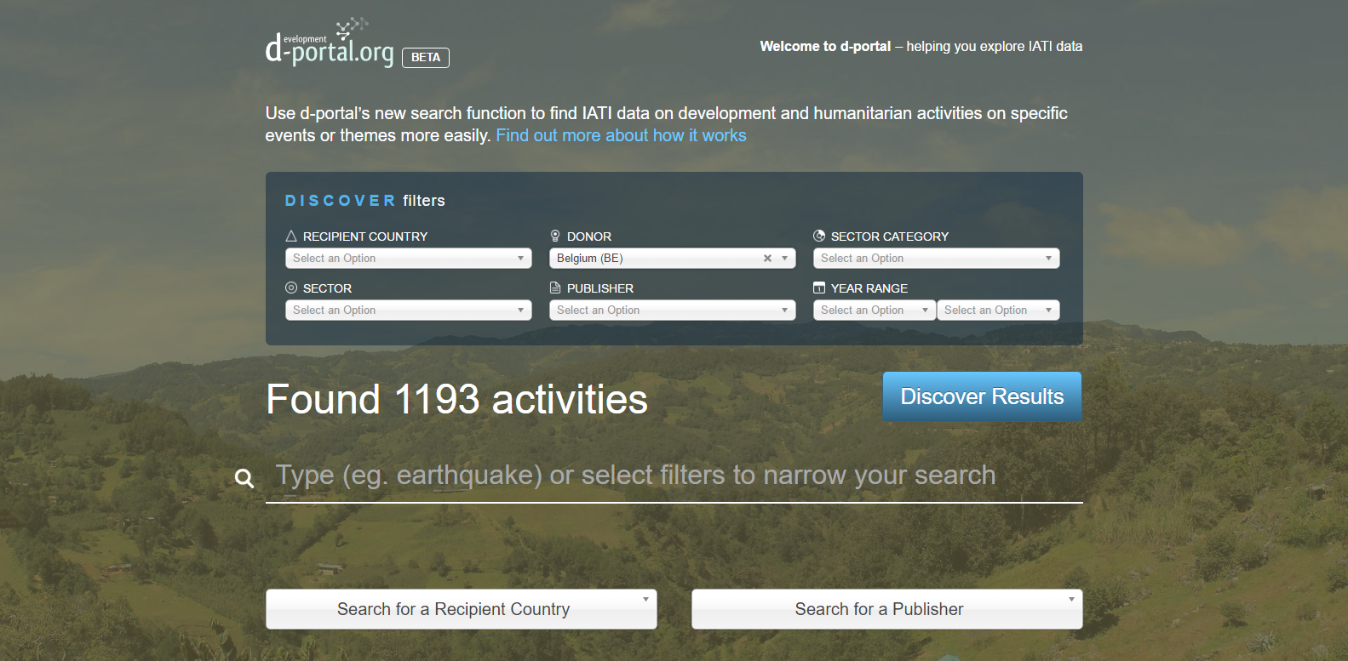
D-portal: Who’s working where, and what are they doing?
Notes:
Use DGD example here

Slide 5
Exercise: Looking at IATI data
Using your laptop, go to:
http://d-portal.org/
Choose the donor ‘Belgium’ and look at DGD’s data.
What information can you find?
How useful do you think this information is:
For your own organisation
For other people/sectors (example: news organisations, other governments)
What’s missing?

Slide 6
What activity information is shared using IATI?
What
When
Where
title
start date
region
Who
participating organisations:
How much?
incoming funds
expenditures
money spent directly by organisations
budgets
description (general, beneficiaries etc)
programme area
end date
Other
URL links to project documents
Organisations’ website address
results
funding
implementing
country (not both)
money sent to implementing partners
Organisation’s email address
Notes:
Broadly, most partners will be required to publish a core set of fields, called elements in IATI, which really make sure that the data is useful and usable.

Slide 7
Financial information
Transaction | Description
Incoming fund (recorded when it happens) | Payment received from funder or partner for the activity
Disbursement (recorded when it happens) | Payment made to the implementing partner organisations (if any).
Expenditure (recorded when it happens) | Money spent on goods and services for the project
Incoming Commitment (recorded when the grant or contract is agreed) | Money promised to the project by a donor through a grant or contract.
Budget (recorded at the start of each financial year, and can include future years) | The amount of money that will be provided to the activity by the reporting organisation, for a 12 month period (or less)

Slide 8
Results information
Type of information | Description | How to record
Indicator | How you will measure the results of your activity. | IATI Results: Indicator element
Baseline | Your starting point. # of working waterpoints in community. | IATI Results: Baseline element
Target | The results you want to achieve ie an increase of 20 working waterpoints. | IATI Results: Target element
Actual result | The direct results of your project: increase in # of working waterpoints. | IATI Results: Actual element
Output and outcome results can be recorded. Results can be set to be aggregated or not aggregated with the data of other reporting organisations.

Slide 9
Accountability: Tracking the money from donor to local activity

Slide 10
The workshop
0 – 60 minutes
Brief presentation on the International Aid Transparency Initiative and open data standard.
Look at IATI data in ‘human-friendly’ website d-portal
Discussion of the types of information shared via IATI: project information, financial information and results
60 – 120 minutes
Talking together about risks and benefits of sharing open IATI data
Decisions that your organisation needs to make before you start using IATI
Creating your organisation’s IATI identifier
120 minutes – 180 minutes
Using the free software ‘AidStream’ to share information using IATI

Slide 11
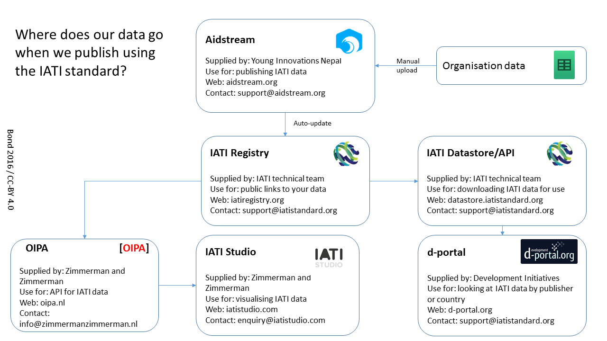
How do we publish data and where does it go?
Or via organisations’ own systems

Slide 12
Types of risks and benefits to consider
Risks:
IATI data is open data – no control over who uses it, how they use it or where they use it.
Reputation – data has errors, data quality is poor, lack of context (results)
Negative use of the data – press, governments
Benefits:
Efficiency within your organisation – internal communication, alignment of systems
External communication – telling your story in a different way
Data philanthropy – contributing your data to the development community.

Slide 13
Exercise: Risks and benefits
Talk to the people next to you:
What risks do you think sharing information using IATI might present for your organisation?
How do you think your organisation can reduce these risks?
What benefits can you see for your own organisation from sharing information using IATI?

Slide 14
Additional risks
Security and safety: Information that may pose a risk to the security or safety of any individual, including beneficiaries, staff and/or partners.
Political or controversial: Information made sensitive by current political issues (in-country or domestically).
Personal information: Information that intrudes on the privacy of a person or could contravene confidentiality.

Slide 15
Decisions to make within your organisation
What is our objective with sharing information using IATI?
      Just meet DGD requirements (compliance)
      Use our data and make it useful to others (investment)
      Become more transparent and accountable
  2. Who is going to lead/manage IATI within our organisation, and who else needs to be involved (IT, finance, programme, communications)
  3. How are we going to build knowledge/skills within our organisation (and how will we resource it?)
  4. How will we decide what data to include, and what to exclude?
  5. How will we produce our data? AidStream or our own system? How will we resource this?
  6. How will we monitor the quality of our data, and how it is being used?

Slide 16
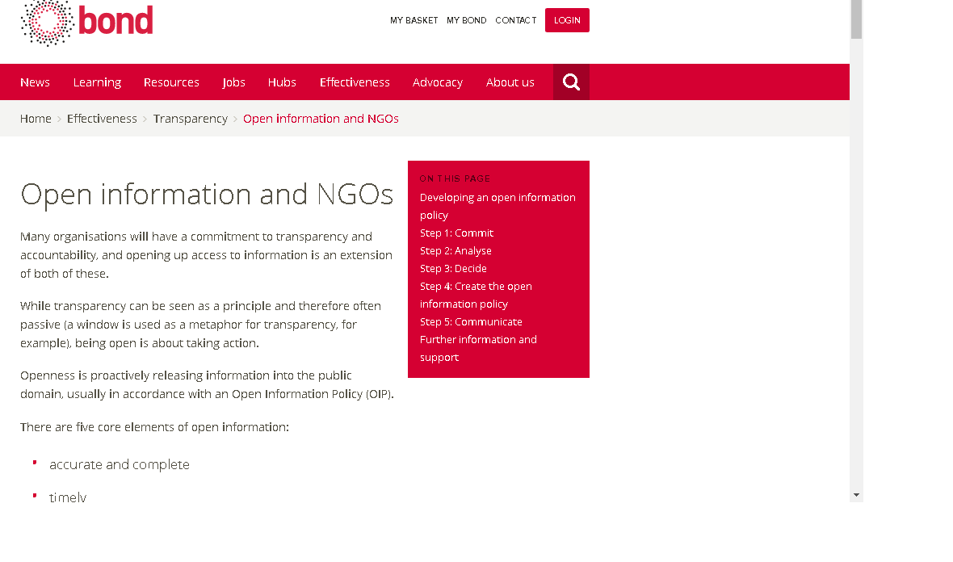
Talking about exclusions: Open information policy

Slide 17
The workshop
0 – 60 minutes
Brief presentation on the International Aid Transparency Initiative and open data standard.
Look at IATI data in ‘human-friendly’ website d-portal
Discussion of the types of information shared via IATI: project information, financial information and results
60 – 120 minutes
Talking together about risks and benefits of sharing open IATI data
Decisions that your organisation needs to make before you start using IATI
Creating your organisation’s IATI identifier
120 minutes – 180 minutes
Using the free software ‘AidStream’ to share information using IATI

Slide 18
Creating an organisation IATI identifier
1. Start with the country code for the country of registration for your organisation: BE-
2. Add the code for the registration authority: BCE_KBO
3. Add your organisation’s registration number (in this example 123456 is the registration number)
BE-BCE_KBO-123456

Slide 19
Creating an activity identifier
1. Each activity must have a unique identifier – the activity identifier.
2. Start with your organisation’s IATI identifier: BE-BCE_KBO-123456
3. Add in an additional unique code that represents your activity, for example: PKEN012
BE-BCE_KBO-123456- PKEN012
If you are reporting on an activity that is shared with other organisations, and they are also reporting to IATI, you still need to have a unique identifier but you can link to the other organisations’ data using the related activity field. You will also need to discuss with them how you avoid duplicating financial and results information.

Slide 20
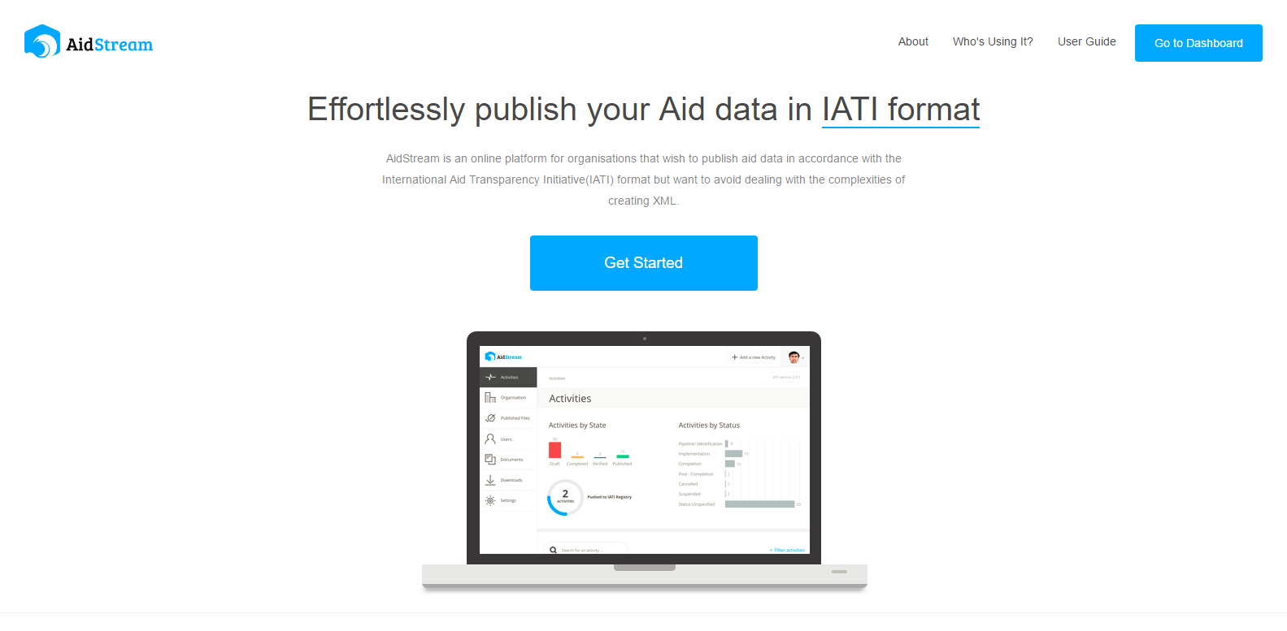

Slide 21
Thank you and useful links
IATI Standard (technical information): www.iatistandard.org
IATI Registry (where all the links to the data are found): http://www.iatiregistry.org/
Bond IATI information: https://www.bond.org.uk/effectiveness/iati
IATI support: support@iatistandard.org
Creating an open information policy: https://www.bond.org.uk/effectiveness/open-information-and-ngos
Aidstream guidance: https://www.bond.org.uk/effectiveness/aidstream
D-portal: www.d-portal.org
List of other websites using IATI data: https://www.bond.org.uk/effectiveness/websites-using-iati-data

